Slide 1
Navigation and 3D Mapping with ROS2
Software Architectures for Robotics (A.Y. 2021/22)
Michele Pestarino (4672010)
Federico Sacco (4672032)
Thomas Campagnolo (5343274)

Slide 2
Navigation2

Slide 3
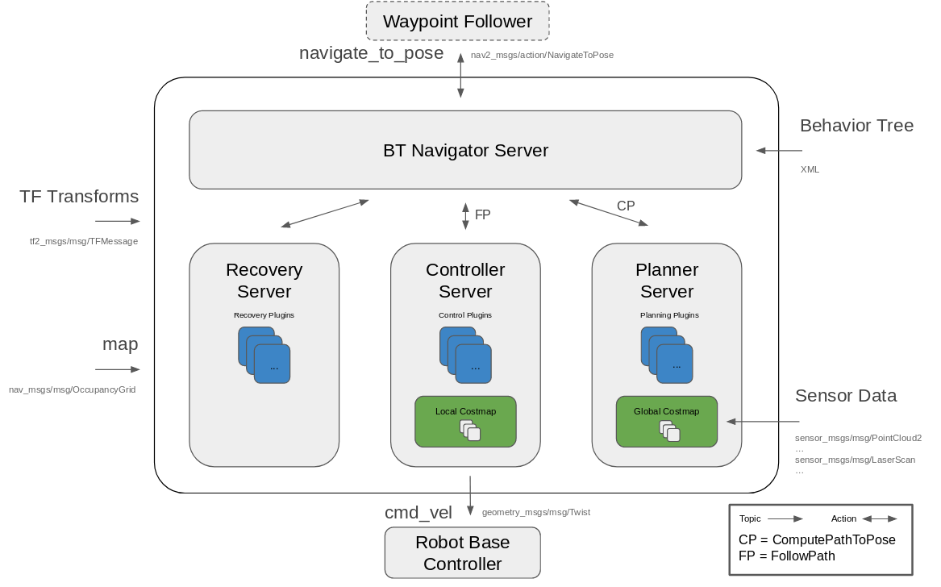
Navigation2 - Overview
Autonomous mobile robot navigation framework based on independent modular servers.
Behavior Tree-based navigation.
Multiple local trajectory and path planners.
Sensors processing for collision avoidance.
But also: recovery behaviors, positioning system, lifecycle manager.
https://navigation.ros.org/index.html

Slide 4
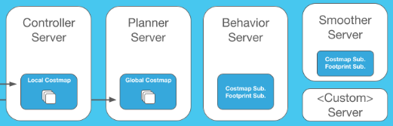
Navigation2 - Overview
Independent Servers and Plugins
Map Server, load, and store maps
AMCL, localize the robot on the map
Nav2 Planner, plan a path from A to B around obstacles
Nav2 Controller, control the robot as it follows the path
Nav2 Smoother, smooth path plans to be more continuous and feasible
Nav2 Costmap 2D, convert sensor data into a costmap representation of the world
Nav2 Recoveries, compute recovery behaviors in case of failure
Nav2 Core, plugins to enable your own custom algorithms and behaviors
https://navigation.ros.org/index.html

Slide 5
Spatio-Temporal Voxel Layer (STVL)

Slide 6
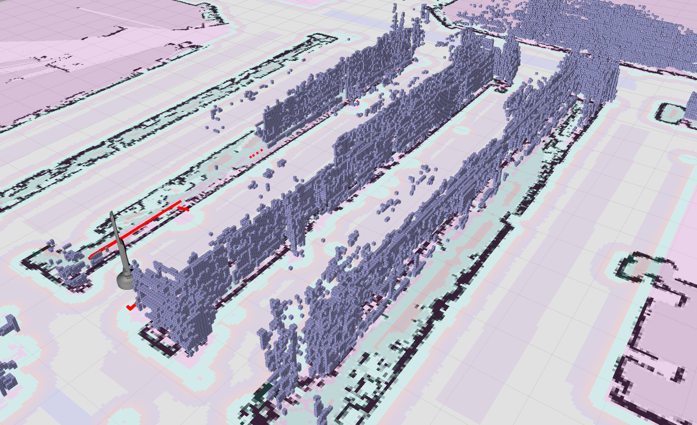
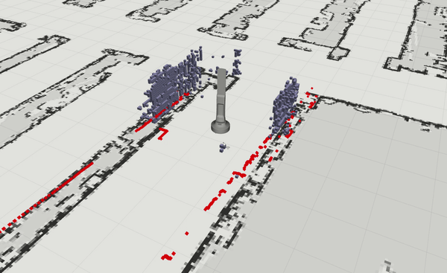
STVL - Overview
Navigation2 plugin that efficiently maintains temporal 3D sparse volumetric voxel grid with decay through sensor models
Replacement for the standard voxel representation of the environment
Wrapped with ROS tools and interfaces to the navigation stack for uses in standard ROS configurations and other systems
https://github.com/SteveMacenski/spatio_temporal_voxel_layer/

Slide 7
Why STVL?
-Temporal
Configurable voxel decay time
Persistent mapping capabilities provided by service
Graphics optimization
Spatio-
Configurable voxel size and general appearance in rviz
Configurable max and min perceived obstacle height
Range within which obstacles are voxelized
No assumption on a static environment or map size
No maximum number of voxel height constraint
https://github.com/SteveMacenski/spatio_temporal_voxel_layer/

Slide 8
Why STVL?
Local Costmap
- use of the information coming from the robot before the decay time for the local cost map
- operate with more information than other times when the speed is faster or slower
- decay time 5-15 seconds nominally good
Global Costmap
- time of 15-45 seconds due to things moving in the scene (e.g. shop, warehouse, construction zone, office, etc.)
- possibility of not decaying the voxels in the global map
permanent voxels set decay to -1 (not recommended for planar lidars)
Mapping
- map an environment in 3D in real-time
mapping mode will maintain the entire voxel grid and save the map using the services provided (maps may be visualized using vdb_viewer)
- run multiple instances of the layer one to map and other to navigate
https://github.com/SteveMacenski/spatio_temporal_voxel_layer/

Slide 9
Linorobot2

Slide 10
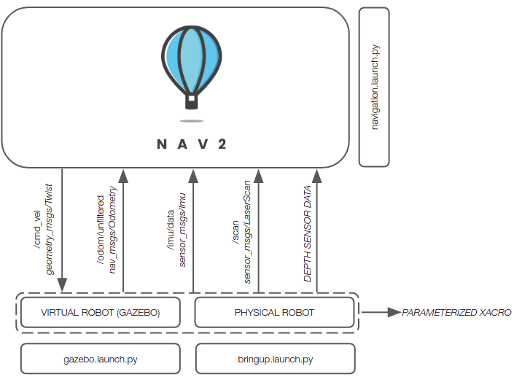
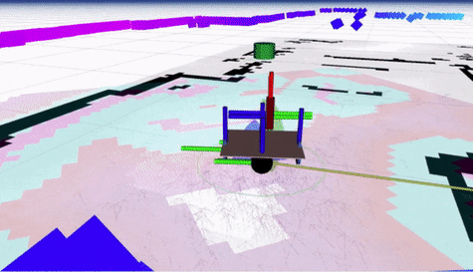
Linorobot2 Simulation
ROS2 framework for simulation with the following characteristics:
Parameterized URDF and xacro files
SLAM features
Nav2 integration
https://github.com/mic-pest/SofAr_assignment/tree/master/linorobot2

Slide 11

Project Outline
URDF files modification
LiDAR 3D
RGBD camera
Sensor tuning
SLAM features
Maps yaml files creation
Integration with Spatio-Temporal Voxel Layer (STVL) Nav2 plugin
https://github.com/mic-pest/SofAr_assignment/tree/master/linorobot2

Slide 12
Linorobot2 Simulation
Foto modello robot
Screenshot mappe usate

Slide 13
Linorobot2 Simulation – Office Environment
3D LiDAR Sensor voxel grid
3D LiDAR sensor pointcloud
Breve descrizione dei topic, dimensione voxel ecc….
Analizzare le differenze
Breve descrizione dei topic, dimensione voxel ecc….
Analizzare le differenze

Slide 14
Linorobot2 Simulation – Playground Environment
RGB-D Sensor voxel grid
RGB-D Sensor pointcloud
VIDEO RVIZ
VIDEO RVIZ

Slide 15
Linorobot2 Simulation – 3D LiDAR vs RGB-D
3D LiDAR Sensor
RGB-D Sensor
PRO / CONTRO
PRO / CONTRO

Slide 16
UML – Unified Modelling Language

Slide 17
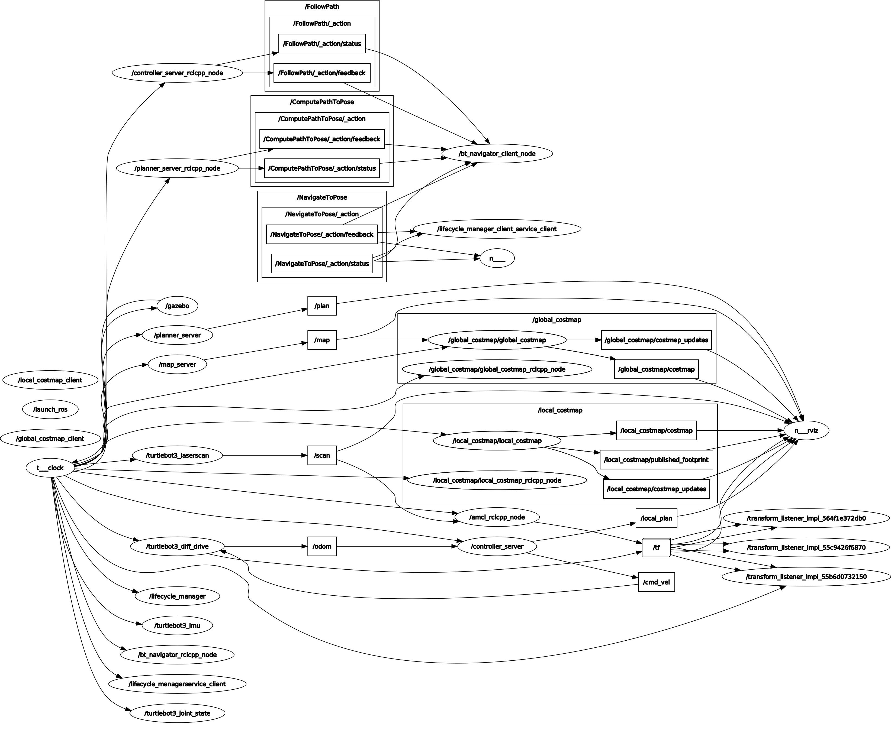
Nav2 RQT Topic’s Graph

Slide 18
What’s Next?

Slide 19
What’s Next?
Implementazione su altri tipi di robot

Slide 20
Repository, Documentation and Issue
Tutti i link delle repository, documentazioni ecc… (nostra repo, nav2, STVL, …)

